Slide 1
Advanced SQL
Advanced DBMS (IGNOU MCS 043 )
Block 1 – Unit 3

Slide 2
Agenda
Assertions
Views
Embedded and Dynamic SQL
Triggers

Slide 3
Assertions
General constraints on multiple tables or columns
The DBMS enforces the assertions so that they are not violated
Assertions are checked whenever there is a related change in the tables
They are applicable at the transaction level
They may span over multiple tables

Slide 4
Assertions
Syntax
CREATE ASSERTION <Name> CHECK (<Condition>);
It is impossible to COMMIT any operation that would cause the assertion's search condition to evaluate to FALSE
It could mean locking the whole table or even the entire database

Slide 5
Assertion - Example
Assertion on age for University students:
CREATE ASSERTION age-constraint
CHECK (NOT EXISTS (
SELECT * FROM STUDENT s
WHERE s.age > 25
OR s.age > (SELECT MIN (f.age) FROM FACULTY f ));

Slide 6
Assertion vs Constraint
An assertion is checked once per transaction
A constraint is checked for each record of the table
Eg: Customer and loans

Slide 7
Views
Virtual table
A query that works on a physical table
Hides the logic of join of tables from the users
Indexes can be built on views to speed-up performance

Slide 8
Views
Syntax
CREATE OR REPLACE VIEW <Name> AS (<Select query>);
DROP VIEW <Name>;
Eg: A student’s database

Slide 9
Views – DML Operations
View from a single table
PRIMARY KEY and NOT NULL columns must be included in the Insert statement
There should be no aggregate functions or GROUP BY clause in the view definition
Views formed by joining multiple tables are generally not updatable
WITH CHECK OPTION clause of sql
CREATE VIEW v1 AS SELECT * FROM t1 WHERE a < 2 WITH CHECK OPTION;

Slide 10
Embedded SQL
SQL statements can be put in application programs in C, Java or any other language
These are static statements as they do not change automatically during the lifetime of a program.
Code is prefixed and terminated by keywords: EXEC SQL
Uses host variables to move data between application and db
Input host variables
Output host variables

Slide 11
Embedded SQL - Cursors
Pointer to the current record
Used to repeatedly fetch a record and do some processing on it
Keywords: DECLARE, OPEN, CLOSE, FETCH
Attributes: ISOPEN, FOUND, ROWCOUNT
Cursor Types: Implicit and explicit
Example

Slide 12
Dynamic SQL
Composing and executing SQL queries at runtime.
Provide flexibility
Complex queries can be written
Very powerful as application logic can be built at runtime.
Require more processing time
Example

Slide 13
SQLJ
To embed SQL statements in Java code
Uses only embedded SQL and no dynamic SQL is possible
Variables can be shared with Java code
Pre compiles SQL code in Java
Overall lines of code is reduced
Statements – Declarations and executables
Enclosed in keyword #sql
Example

Slide 14
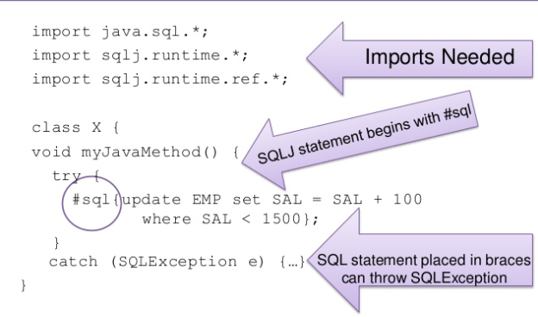
SQLJ

Slide 15
Triggers
A procedure that runs automatically when a certain event occurs in the DBMS
Three components
Event: When this event happens, the trigger is activated
Condition (optional): If the condition is true, the trigger executes, otherwise skipped
Action: The actions performed by the trigger
Semantics
When the Event occurs and Condition is true, execute the Action

Slide 16
Triggers
Three event types
Insert
Update
Delete
Two triggering times
Before the event
After the event
Two granularities
Execute for each row
Execute for each statement

Slide 17
Triggers
Uses
To generate audit trails
To enforce business rules

Slide 18
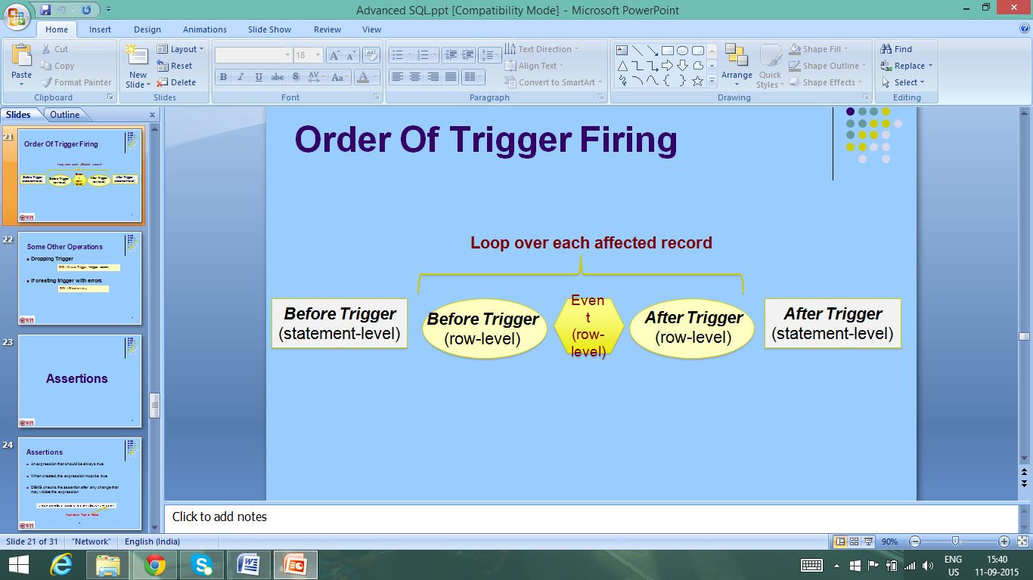
Triggers

Slide 19
Triggers
Syntax
Create Trigger <name>
Before| After Insert| Update| Delete
For Each Row | For Each Statement

Slide 20
Triggers
Example: If the employee salary increased by more than 10%, make sure the ‘rank’ field is not empty and its value has changed, otherwise reject the update
Create or Replace Trigger EmpSal
Before Update On Employee
For Each Row
Begin
IF (:new.salary > (:old.salary * 1.1)) Then
IF (:new.rank is null or :new.rank = :old.rank) Then
RAISE_APPLICATION_ERROR(-20004, 'rank field not correct');
End IF;
End IF;
End;

Slide 21
Triggers
Row-level triggers
Check individual values and can update them
Have access to :new and :old vectors
Statement-level triggers
Do not have access to :new or :old vectors (only for row-level)
Execute once for the entire statement regardless how many records are affected
Used for verification before or after the statement

Slide 22
Triggers are tricky!
Hard to troubleshoot
One trigger may fire another trigger and may lead to a trigger storm
Try to move all logic at application level rather than db triggers.
They increase the workload of the database and makes the system slow

Slide 23
Thank You

